Slide 1
MGO 665 Technology Entrepreneurship
Group 3:
1. Ashutosh Jainvi - ajainvi@buffalo.edu - 50207263 2. Jay Bakshi - jaybaksh@buffalo.edu - 50206954 3. Ryan Gurian - ryanguri@buffalo.edu - 50066861 4. Tushar Rajan Pavaskar - tpavaska@buffalo.edu - 50207557 5. Yingkai Yang - yingkaiy@buffalo.edu - 50076927
Notes:
Convince that this is not just an idea
Tell whether and why this is a business opportunity worthy of pursuit at this time
Feasibility of the opportunity – Do you have a coherent compelling story?
Problem and solution
Market and customer
Industry, competition and competitive advantage
Revenue model
Test hypotheses with customers Opportunity analysis
3 Elements Items Points
What is the business concept? (problem and solution) 20%
Who are the target customers? Is it an attractive market (segment)? What is your customer value proposition? 15%
Who are your key competitors? What makes your concept differentiated from competition (competitor analysis)? Does your venture have a favorable context? 15%
How do you monetize? What is the primary revenue stream? What is your revenue model for the revenue stream? 15%
What have you learned from customer visits/interactions? Do you have any customer validation (customer engagement evidence, secondary data, first customers)? 20%
Do you have a coherent compelling story overall? Is your presentation convincing? 15%

Slide 2

For students. By students. Of students.

Slide 3
Problem?
One Course , many education portals.
No platform for student entrepreneurs to find better opportunity.
UB already has these life-hackers ALREADY !

Slide 4
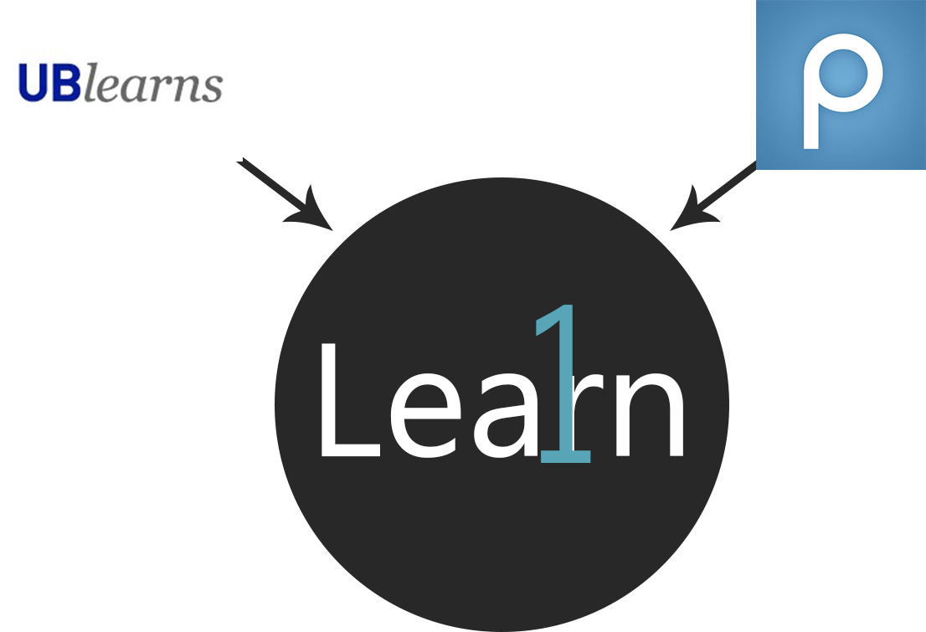
Problem?
No worries.. Learn One’s here
About time we use this knowledge put to use!
A 1-stop solution

Slide 5
Target Customers
Target Audience
Students enrolled in any kind of program/course in a university.
Students who need online portals for supporting course material.
Demographics
Male/female 18-25 years.

Slide 6

Market Segmentation
As our target audience - STUDENTS. Our product focus on Education/School market segment.

Slide 7
Customer Value Proposition
Question arises, why the customer will use our product?
As mentioned, our target customers are the students. According to the polls(online survey) conducted - More than 50% students are not satisfied with what they have right now.
We provide what they asked for during the survey.

Slide 8


Competition
Competitors - UBlearns and other campus portal platforms
Why?
Target customer base = college students
Primary source of course tutorials/materials for students to reference
Competitors Shortcomings
Sole function is to allow students access to course related materials
Limited to material from courses the student is currently enrolled in.

Slide 9
Competitive Advantages
More features at ONE PLACE -
Textbook exchange
“BigShot” Feature = communication with entrepreneurs online
No enrollment requirements
Tutorials/Materials from multiple sources
Favorable Context?
Functionality convenient options for the students Cost Effective -> Potentially
MORE

Slide 10
Monetize
Like our competitor, university will pay us to use our project.
We will charge university annually.

Slide 11
Revenue streams
Our business is Single Revenue stream
We are using recurring revenue stream.

Slide 12
Revenue model
Subscription-based
Better utilization of Technology Fee
Revenue growth -
UB @ moment
Word of mouth and marketing plan in the making.
University pay 90%
pay
LEARN ONE
University
Total using fee
Student pay 10% (tuition bill)

Slide 13
Customer Learnings
Customer learnings based upon survey done ONLINE
More than 250 students took two surveys which had questions about -
How much they are SATISFIED with available solutions.

Slide 14
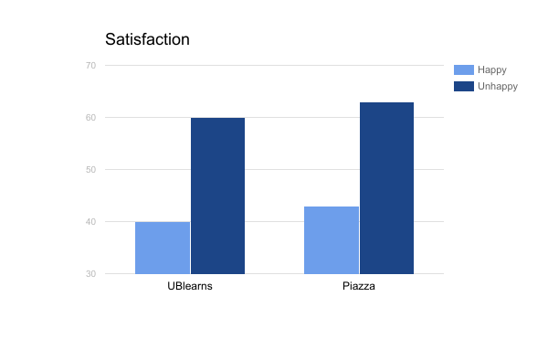
Customer Learnings

Slide 15
Customer Feedbacks
Questions asked -
BIG SHOT = SHARK TANK ?
Difference between UBLearns/Piazza and LEARN ONE ?
Also, customers NOT HAPPY to pay any registration fee and demanded the app for free.

Slide 16
Future Improvements
FREE app for Students
Podcasts for students

Slide 17
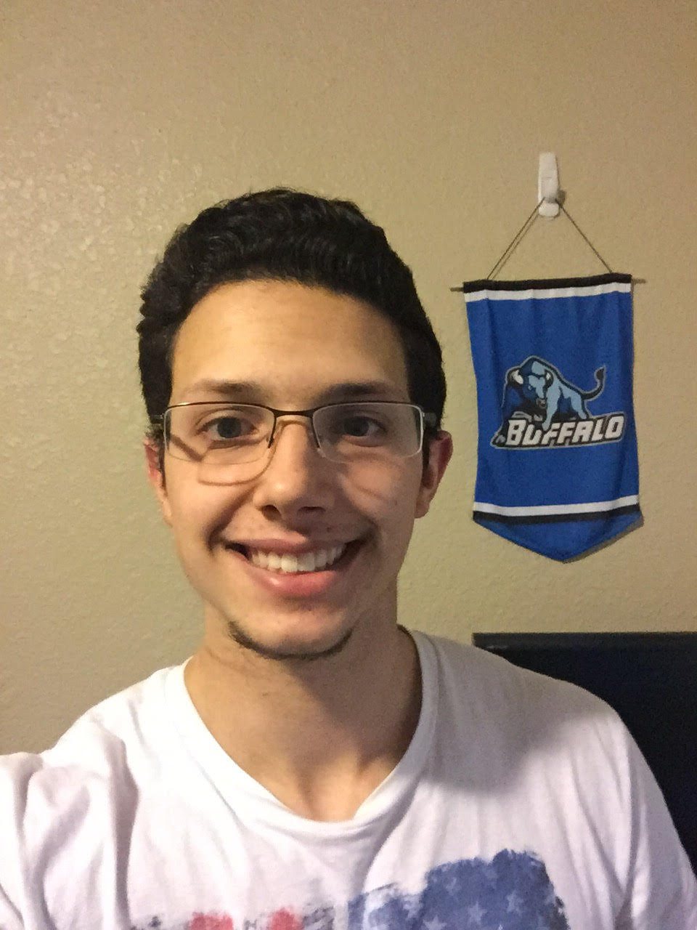

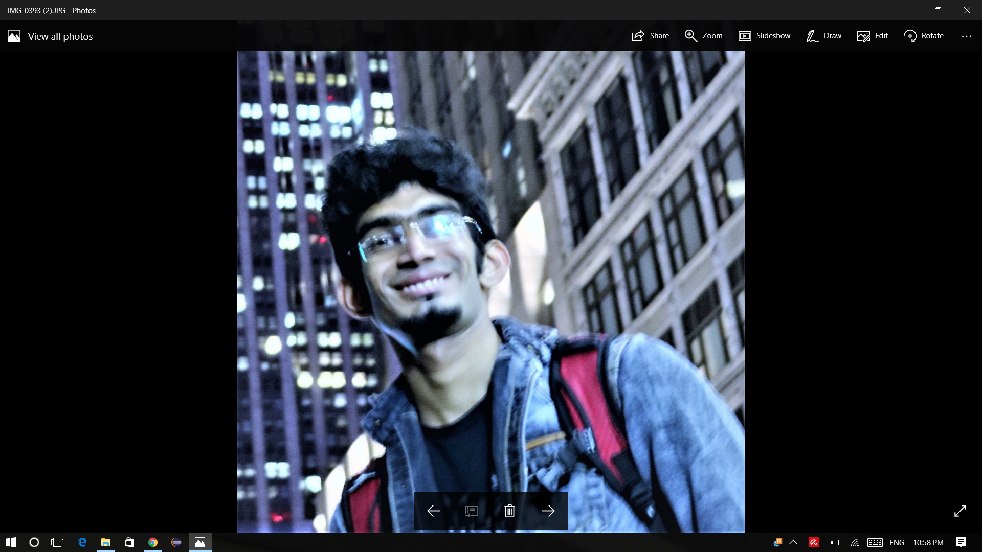
Learn One
Team
Jay Bakshi
Graduate Student Computer Science
jaybaksh@buffalo.edu
Ashutosh Jainvi
Graduate Student Computer Science
ajainvi@buffalo.edu
Ryan Gurian
Senior Mechanical Engineering
ryanguri@buffalo.edu
Yingkai Yang
Senior Mechanical Engineering
yingkaiy@buffalo.edu
Tushar Pavaskar
Graduate Student Electrical Engineering
tpavaska@buffalo.edu

Slide 18
Questions?

